Slide 1
Process analysis
Models for writers - chapter 16

Slide 2
When are do you use process analysis?
When you
give someone directions to your home
tell how to make ice cream
explain how a president is elected

Slide 3
Process analysis
Arranges a series of events in order and relates them to one another.
It tries to explain – in detail – how it happens.

Slide 4
Directional type process analysis
Provides directions on how to do something.
These directions can be brief as the directions for making instant coffee printed on the label or as complex as the directions in a manual for assembling a new gas grill.
Purpose:
To give the reader directions to follow that will lead to the desired results

Slide 5
Consider these directions for sharpening a knife:
If you have never done any whittling or wood carving before, the first skill to learn is how to sharpen your knife. You may be surprised to learn that even a brand-new knife needs sharpening. Knives are never sold honed (finely sharpened), although some gouges and chisels are. It is essential to learn the firm stroke on the stone that will keep your blades sharp. The sharpening stone must be fixed in place on the table, so that it will not move around. You can do this by placing a piece of rubber inner tube or a thin piece of foam rubber under it. Or you can tack four strips of wood, if you have a rough worktable, to frame the stone and hold it in place. Put a generous puddle of oil on the stone — this will soon disappear into the surface of a new stone, and you will need to keep adding more oil. Press the knife blade flat against the stone in the puddle of oil, using your index finger. Whichever way the cutting edge of the knife faces is the side of the blade that should get a little more pressure. Move the blade around three or four times in a narrow oval about the size of your fingernail, going counterclockwise when the sharp edge is facing right. Now turn the blade over in the same spot on the stone, press hard, and move it around the small oval clockwise, with more pressure on the cutting edge that faces left. Repeat the ovals, flipping the knife blade over six or seven times, and applying lighter pressure to the blade the last two times. Wipe the blade clean with a piece of rag or tissue and rub it flat on the piece of leather strop at least twice on each side. Stroke away from the cutting edge to remove the little burr of metal that may be left on the blade.

Slide 6
Informational type process analysis
Tells how something works
Tells how something is made
Tells how something occurs
Purpose:
Rather than giving specific directions, it explains and informs

Slide 7
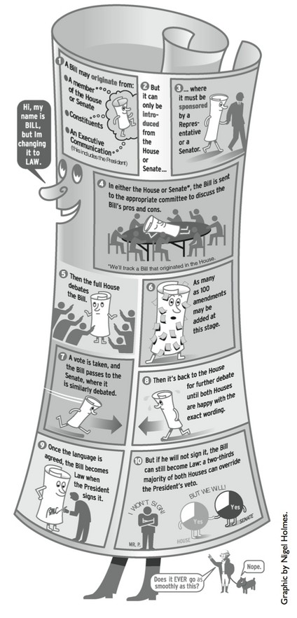
Informational type
This illustration uses informational type process analysis to explain a basic legislative procedure – how a bill becomes a law.
Notice it is divided into steps.

